Slide 1
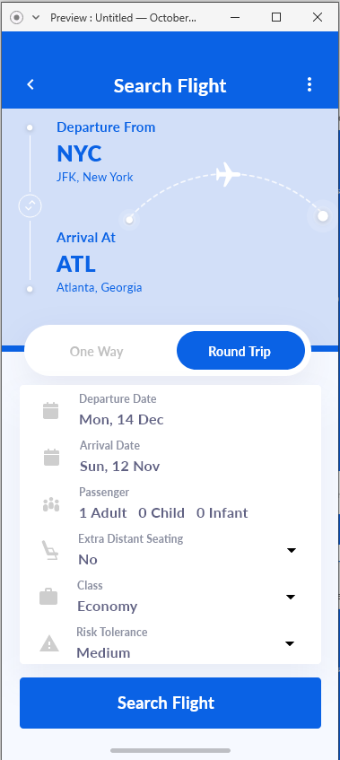
A note: I created all the designs in Adobe XD so whoever is looking at this, if you have Adobe XD installed you will be able to run through some of the designs (I added some minimal function as part of the prototyping) and interact with buttons. I have attached the file alongside the PowerPoint
At the top of each page is a back arrow to go to the previous page
The landing page consists of options to select the departure and arrival location
The three dots at the top right allows the user to go back to the Search flight page from any point in the process
An option for one way or round trip is provided for the user
Here the user can enter in options for their travel dates and passenger count. As well as some extra features such as “Extra Distant Seating” which would allow to user to buy two seats and sit alone in a row. In addition there is an option for the user to identify their risk tolerance which COVID-19
Class option allows for different users (Business Class, Economy Class, and First Class)
Once the sufficient information has been entered, the user can press the Search Flight button and be directed to a page with flights to the destination

Slide 2
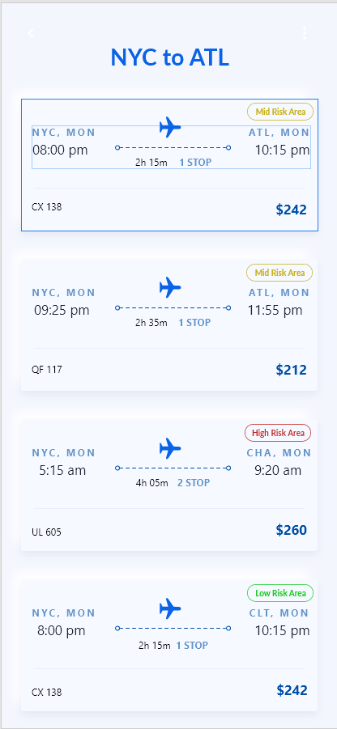
The flight page shows connecting
flights to the location as well as some
Other destinations that are close by with
Differing COVID-19 Risks associated
The first two show direct flights to the destination
If there is a layover, the flight says
2 stops
The second two show locations somewhat close to
The destination with differing Risks. (CHA was added just to
Show how High Risk is show)
If the conditions change for a trip, the user will be sent a push notification through their phone/email which will redirect them to this flight page. Allowing them to look at alternate travel routes and pandemic risks. (I could not find a way to show a push notification/email notification, so it is now shown in the design)

Slide 3
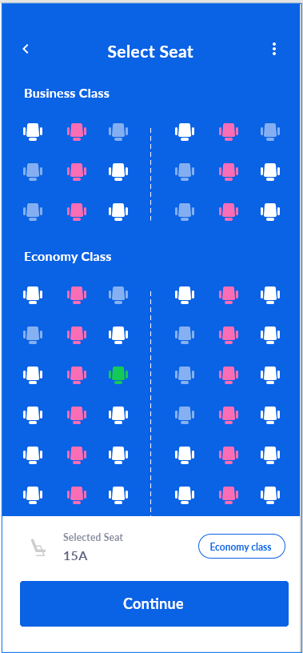
After clicking of a flight that fits the
Users needs, they are brought to a seat
Selection page based off their earlier passenger
Counts. If the user is a single passenger then
They will be shown all available seats that
Correspond with COVID-19 limitations. Meaning
All center row seats will be unavailable.
The user can click on a seat, and the corresponding seat
Will turn green if available. The seat number will be show at the
Bottom of the screen along with the class it is associated with
Once the seat has been selected the user can continue
To the next page

Slide 4
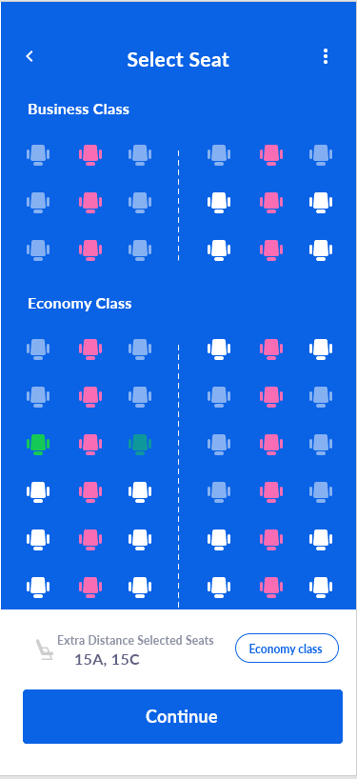
This page shows how the seating
Chart would look if the user chose
The “Extra Distant Seating” option in
The landing page. This option allows
The user to purchase two seats, making
It so that they can sit in a row alone. The
User will only be show seats where both
The row and window seat are still open.
This choice results in a higher price-tag for
User and more money for the airline
When a seat is chose the window seat will be highlighted
And the row seat will be semi-highlighted to represent that
Both seats are being purchased but only one will be used
The corresponding seat numbers and seat class is displayed at
The bottom of the page

Slide 5
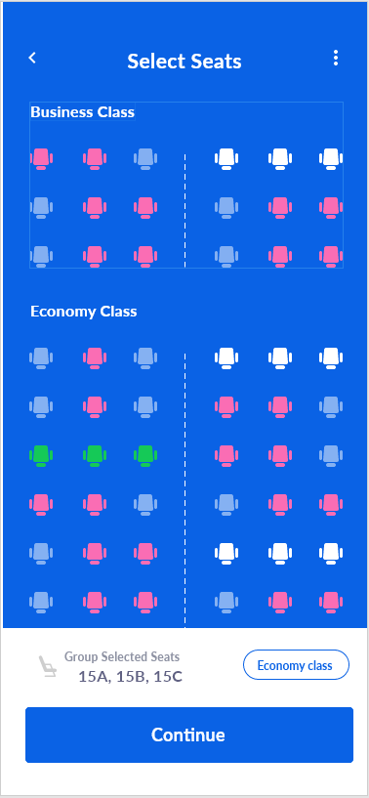
This page shows the seating chart for groups/families of three.
If the user has chose to travel will their family, they will be
Allowed to sit with other family members, bypassing the covid-19
Restriction on the middle seat. But this also makes it so that they
Will only be show fill rows of seats. Individual seats available will
Still be shown but will be at a lower opacity. Available rows will
Be shown as white for available. Depending on the amount of
Passengers in a family (Ex. 5) the seating would be able to adjust to
Allow family members to sit together
The row of seats chosen is displayed at the bottom alongside
The class of seats
Once the user has chosen their seats, they will be taken
To a new page with info on the destination

Slide 6
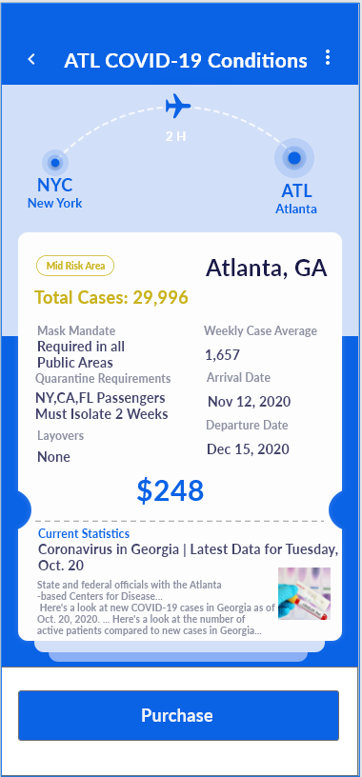
After selecting a seat, the user will
Be shown potential covid-19 conditions
At their destination. Mask Mandate,
Case average, and Quarantine Requirements
Are shown to the user.
The application will check the arrival and departure date of a round
Trip to make sure that the travel is possible with accordance to
Quarantine restrictions. An example of this is shown laters
Any quarantine restrictions from different areas in
The country (or world) could be shown under the
Quarantine requirements.
A link to more information and statistics will be at the
Bottom of the page for users to click if they want to
Learn more
Clicking purchase will prompt the user to a confirmation
page

Slide 7
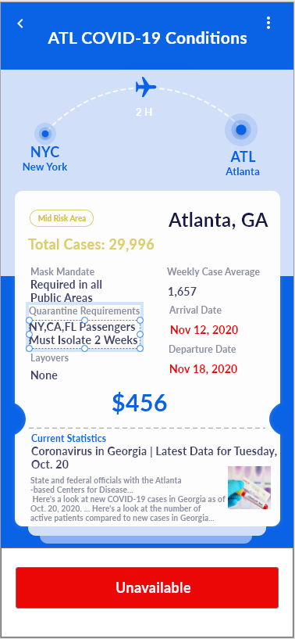
Here the user has an arrival and departure date that
Does not follow the quarantine requirements since they
Are arriving from New York, making it so that the user cannot
purchase the ticket unless the dates are changed

Slide 8
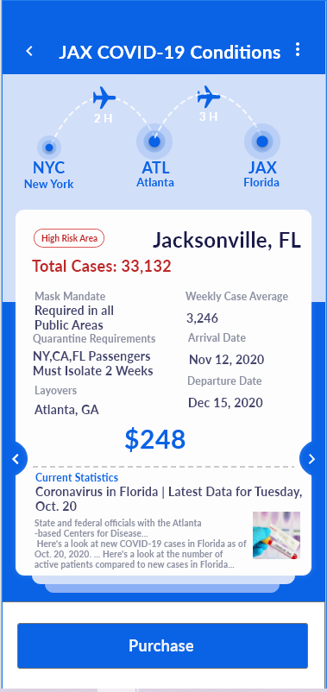
The Risk is updated with the location, making sure the user
Understands how the conditions are at their destination
This page shows how a flight
With a layover would display the
Information relating to Covid-19 at their
destination
The arrows at the side can be used to
Scroll between Layover and Destination
Conditions
If the user clicks purchase, and their risk conditions are below
That of the destination, they will be greeted with a warning

Slide 9
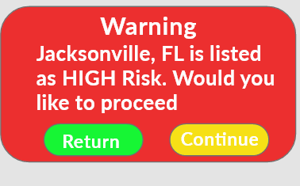
A pop-up will appear
If the users risk conditions
That were set at the main page do not match a locations risk.
Giving the user the option to continue or return to the main flight booking page
Continue will take the user to the confirmation page

Slide 10
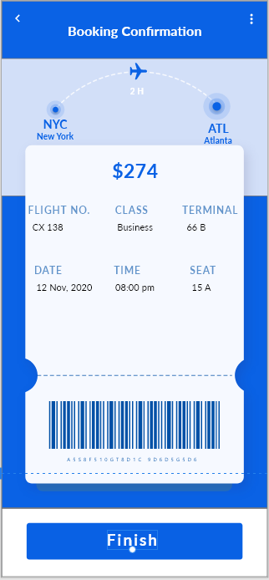
A confirmation page with
The ticket information and
Barcode are shown to the user
For confirmation
Confirming will take the user to either payment methods
Or other information that an airline may have for the user

Slide 11
Eight Golden Rules of Design
1. Strive for Consistency
The design keeps the color pattern and font consistent throughout all of the designs, promoting consistency through pages. The only inconsistency comes with the warning where a color that conveys danger/warning (red) is used to make sure the users attention is grabbed
2. Seek Universal Usability
The design stays simple and informative allowing for a wide range of users to be able to interact. By using many visual points of interest it makes it more usable for people with differences in language. The simple design also allows for someone less experienced to be able to navigate similar to how someone experienced with technology would navigate.
3. Offer Informative Feedback
The user is shown feedback for actions such as selecting their seat and selecting a flight. When the user selects a specific seat, the corresponding seat is show green represent the users action. Choosing a flight will take the user to a page that has details about that specific flight.
4. Design Dialogs to Yield Closure
The design represents the path to closure through the bottom buttons for each page. After choosing seats the user is prompted to “Continue” implying there is still actions to be done. The next page has a purchase option which implies the user will be taking action to pay for the item. The confirmation page has “Finish” at the bottom representing to the user that this is the final step in the process.
5. Prevent Errors
The prevention of errors is most seen at the screen selection page. Taken seats are shown as greyed out, unavailable seats are shown as red, and available seats are shown as white. If the user ever makes an error there are back arrows at the top of each page allowing the user to retrace their steps and correct the mistake. In the landing page, dropdown menus are used to stop and erroneous inputs from the user in important fields
6. Permit Easy Reversal of Actions
On the top left of each page an arrow pointing backwards is show to the user. If the user wants to make any changes or made a mistake in a previous page, they are easily able to go back and reverse any actions
7. Keep Users in Control
The interface allows for users to input information at the main page and not require continuous re-entry of the same information. The design remains similar across all pages allowing for users to understand what action corresponds with what response. The simplicity also helps the user reach their desired result faster
8. Reduce Short term memory load
The user is not required to remember large amounts of information, and an crucial pieces of info (such as COVID-19 Risk state) are continually shown to the user when necessary. The design relies on many visual elements rather than many test elements, reducing the possibility of memory overload

